Slide 1




Spotify
Home
Photo
About Me
Contact
Spotify SQL Project and Query Optimization
BY Somya Agrawal
Using PostgreSQL
01

Slide 2
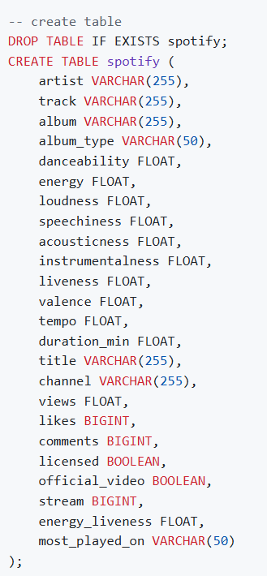
Spotify
Home
Photo
About Me
Contact
QUERY
OVERVIEW
This project involves analyzing a Spotify dataset with various attributes about tracks, albums, and artists using SQL. It covers an end-to-end process of normalizing a denormalized dataset, performing SQL queries of varying complexity (easy, medium, and advanced), and optimizing query performance. The primary goals of the project are to practice advanced SQL skills and generate valuable insights from the dataset.
02

Slide 3
Spotify
Home
Photo
About Me
Contact
Project Steps
Data Exploration
Before diving into SQL, it’s important to understand the dataset thoroughly. The dataset contains attributes such as:
Artist: The performer of the track.
Track: The name of the song.
Album: The album to which the track belongs.
Album_type: The type of album (e.g., single or album).
Various metrics such as danceability, energy, loudness, tempo, and more.
2. Querying the Data
After the data is inserted, various SQL queries can be written to explore and analyze the data. Queries are categorized into easy, medium, and advanced levels to help progressively develop SQL proficiency.
Easy Queries
Medium Queries
Advanced Queries
3. Query Optimization
In advanced stages, the focus shifts to improving query performance. Some optimization strategies include:
Indexing: Adding indexes on frequently queried columns.
Query Execution Plan: Using EXPLAIN ANALYZE to review and refine query performance.
03

Slide 4
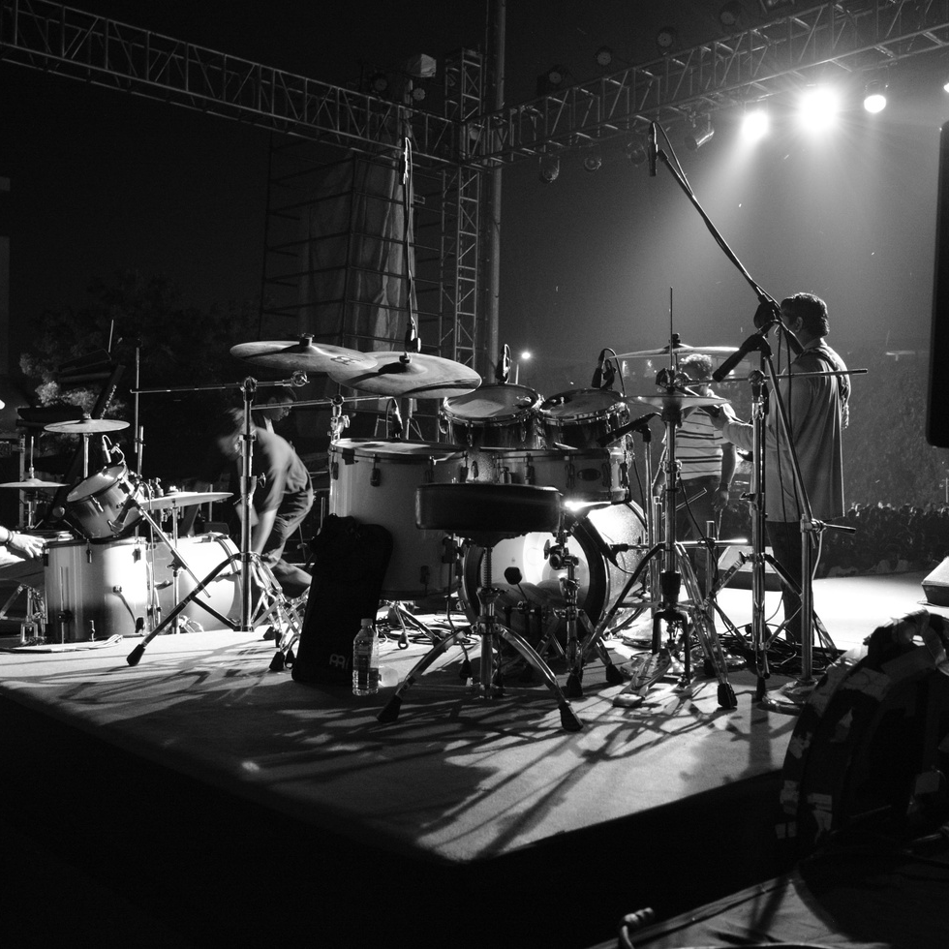
Spotify
Home
Photo
About Me
Contact
15 Practice Questions
01
Easy Level
02
Medium Level
03
Advanced Level
04

Slide 5
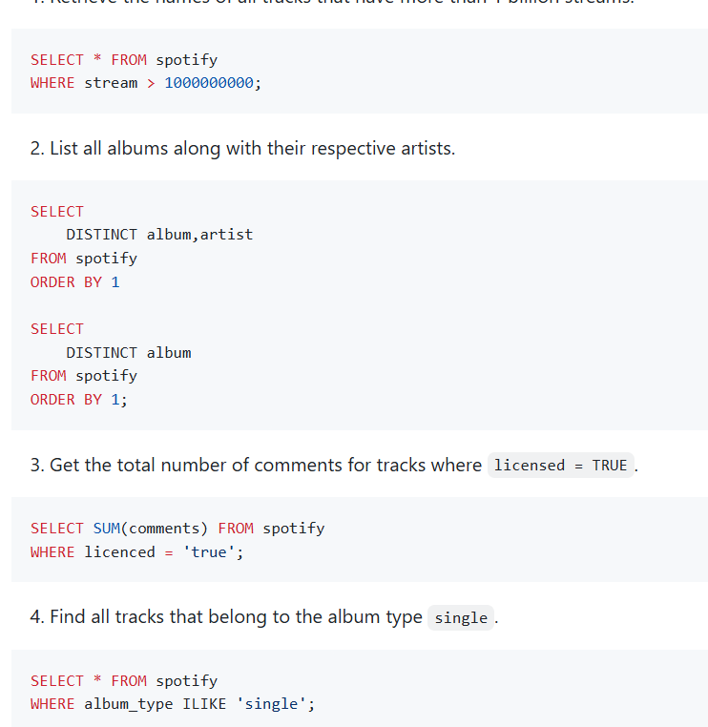
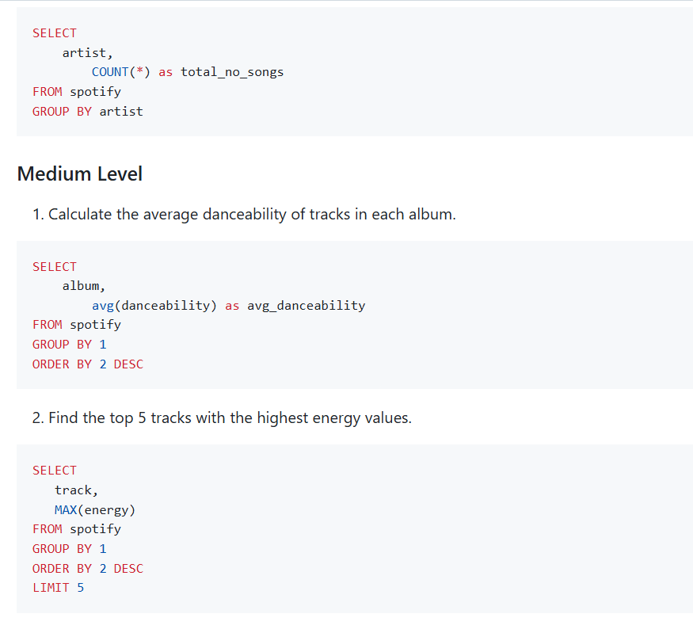
Spotify
Home
Photo
About Me
Contact
Easy Level
01
Retrieve the names of all tracks that have more than 1 billion streams.
02
List all albums along with their respective artists.
Get the total number of comments for tracks where `licensed = TRUE`.
03
Find all tracks that belong to the album type `single`.
04
Count the total number of tracks by each artist.
05
05

Slide 6
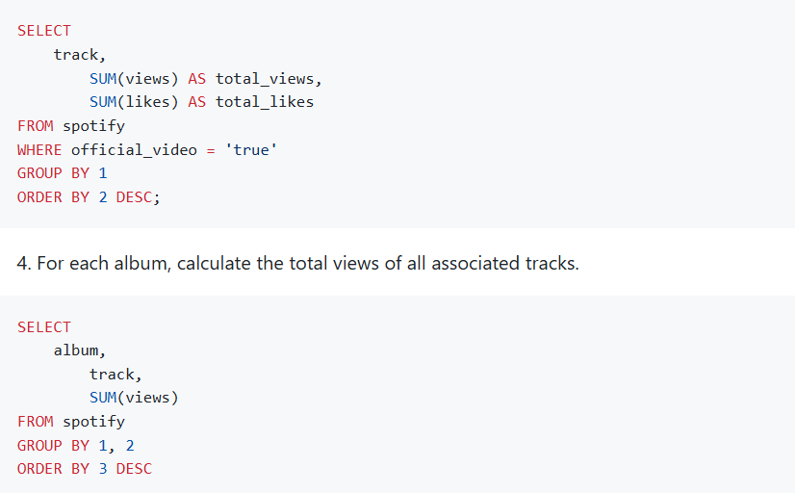
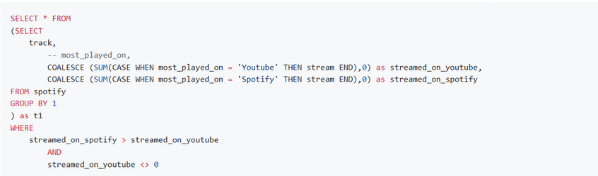
Spotify
Home
Photo
About Me
Contact
MEDIUM Level
01
Calculate the average danceability of tracks in each album.
02
Find the top 5 tracks with the highest energy values.
List all tracks along with their views and likes where `official_video = TRUE`.
03
For each album, calculate the total views of all associated tracks.
04
Retrieve the track names that have been streamed on Spotify more than YouTube.
05
06

Slide 7
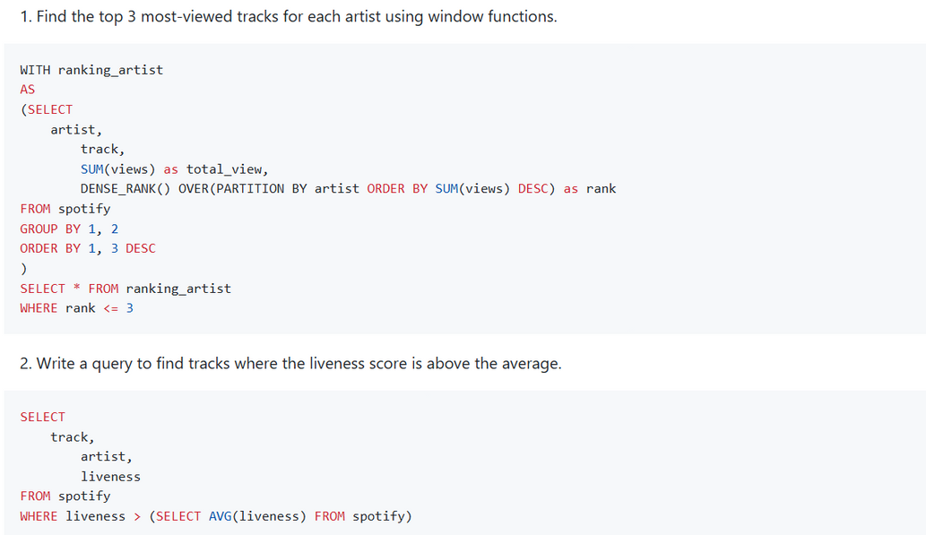
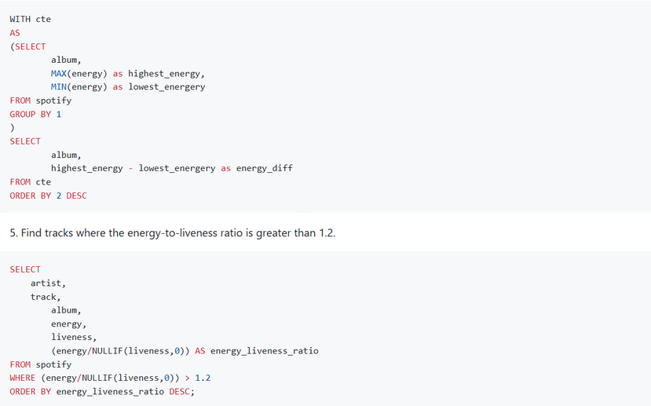
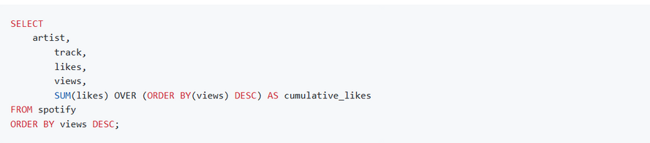
Spotify
Home
Photo
About Me
Contact
ADVANCED Level
01
Find the top 3 most-viewed tracks for each artist using window functions.
Write a query to find tracks where the liveness score is above the average.
02
Use a `WITH` clause to calculate the difference between the highest and lowest energy values for tracks in each album.
03
Find tracks where the energy-to-liveness ratio is greater than 1.2.
04
Calculate the cumulative sum of likes for tracks ordered by the number of views, using window functions.
05
07

Slide 8
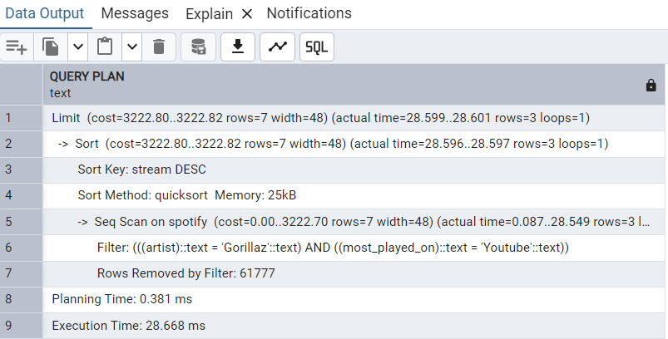
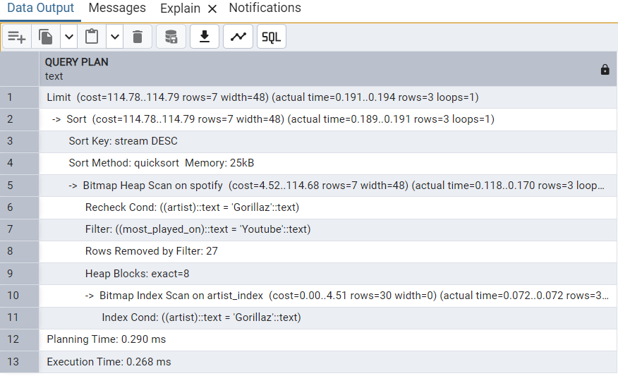
Studio Shodwe
Home
Photo
About Me
Contact
Initial Query Performance Analysis Using EXPLAIN
Performance Analysis After Index Creation
08

Slide 9
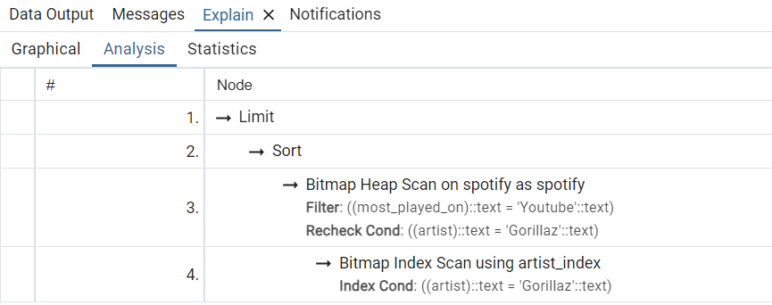
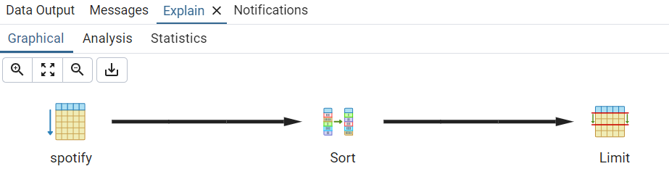
Studio Shodwe
Home
Photo
About Me
Contact
Graphical Performance Comparison
09

Slide 10

Spotify
Home
Photo
About Me
Contact
Thank You
10

